Slide 1
Neural Networks and Deep Learning
By –
Bhaskarjit Sarmah

Slide 2
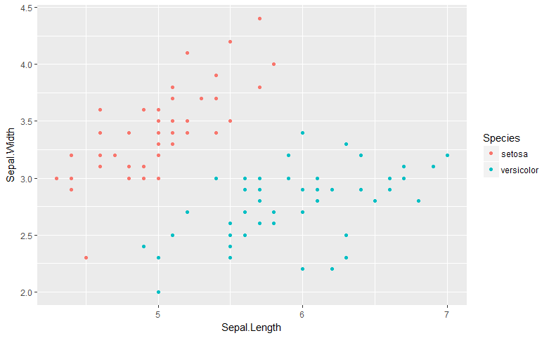
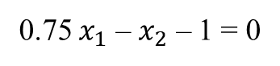
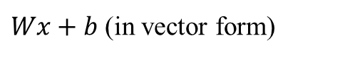
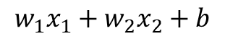
Classification Problem: A Primer
Classification Boundary
0.75 $x_{1}$ – $x_{2}$ – 1 = 0
Score
0.75 * Sepal.Length – Sepal.Width – 1
Prediction
Score >= 0: Versicolor
Score < 0: Setosa
In General
$$w_{1}x_{1}+w_{2}x_{2}+b$$
$Wx+b$ (in vector form)
A New Flower
Sepal.Length = 6.5
Sepal.Width = 3
Which category it would fall in?

Slide 3
Perceptron: Building Block of Neural Networks
Score
0.75 * Sepal.Length – Sepal.Width – 1
Weights
Bias
Sepal.Length = 6.5
0.75
-1
Output
Setosa/Versicolor
-1
Sepal.Width = 3

Slide 4
Perceptron: Building Block of Neural Networks
Sepal.Length = 6.5
0.75
Score
0.75 * 6.5 – 1 * 3 – 1
= 0.875
0.875 >= 0
-1
Versicolor
Sepal.Width = 3
-1
Bias = 1

Slide 5
Perceptron: Building Block of Neural Networks
Sepal.Length = 6.5
0.75
Score
0.75 * 6.5 – 1 * 3 – 1
= 0.875
Versicolor
1
Setosa
Versicolor
Sepal.Width = 3
-1
Linear
Function
Activation
Function
Bias = 1

Slide 6
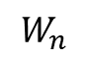
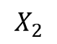
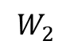
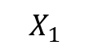
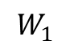
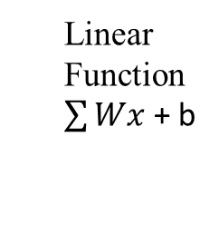
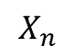
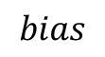
Perceptron: Building Block of Neural Networks
Forward Propagation
$$X_{1}$$
$$W_{1}$$
$$X_{2}$$
$$W_{2}$$
Linear
Function
$\sum{Wx}$ + b
Activation
Function
Output
$$W_{n}$$
$$X_{n}$$
$$bias$$
1

Slide 7
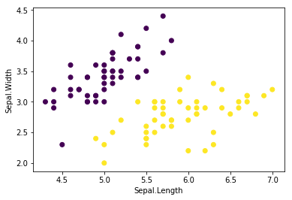
How do we calculate optimal weights and biases?
Come closer
to me
Classifier 1: Initial Classifier with random weights and biases
Classifier 2: Updated weights and biases
Setosa
Classifier 3: Updated weights and biases
Classifier 4: Optimal weights and biases
Versicolor
Come closer
to me

Slide 8
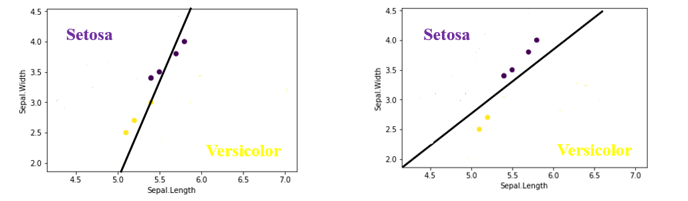
How do we calculate optimal weights and biases?
Our Goal –
Is to formulate a error function and
To optimize (minimize) the error function using Gradient Descent Algorithm
0.6 * 0.6 * 0.4 * 0.4 * 0.4 * 0.4 = 0.009216
0.6 * 0.6 * 0.7 * 0.7 * 0.7 * 0.7 = 0.086436
What do you observe? What we have millions of data points? How to solve this problem?

Slide 9
How do we calculate optimal weights and biases?
Our Goal –
Is to formulate a error function and
To optimize (minimize) the error function using Gradient Descent Algorithm
From increasing MLE to reducing Cross Entropy
0.6 * 0.6 * 0.4 * 0.4 * 0.4 * 0.4 = 0.009216
0.6 * 0.6 * 0.7 * 0.7 * 0.7 * 0.7 = 0.086436
ln(0.6) + ln(0.6) + ln(0.4) + ln(0.4) + ln(0.4) + ln(0.4)
ln(0.6) + ln(0.6) + ln(0.7) + ln(0.7) + ln(0.7) + ln(0.7)
-0.51
-0.51
-0.92
-0.92
-0.92
-0.92
-0.51
-0.51
-0.36
-0.36
-0.36
-0.36
-ln(0.6) - ln(0.6) - ln(0.4) - ln(0.4) - ln(0.4) - ln(0.4)
-ln(0.6) - ln(0.6) - ln(0.7) - ln(0.7) - ln(0.7) - ln(0.7)
0.51
0.51
0.92
0.92
0.92
0.92
0.51
0.51
0.36
0.36
0.36
0.36
0.51 + 0.51 + 0.92 + 0.92 + 0.92 + 0.92= 4.7
0.51 + 0.51 + 0.36 + 0.36 + 0.36 + 0.36= 2.46

Slide 10
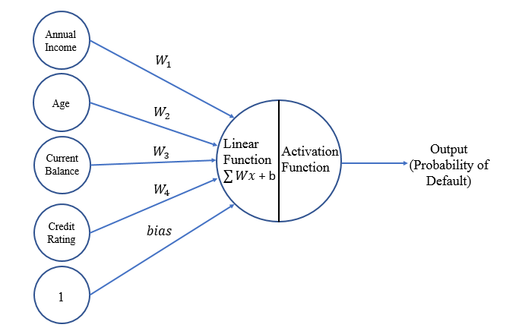
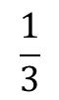
How do we calculate optimal weights and biases?
Our Goal –
Is to formulate a error function and
To optimize (minimize) the error function using Gradient Descent Algorithm
Formulating Cross Entropy Function
Calculated after 1st forward propagation
Annual Income | Age | Current Balance | Credit Rating | Defaulter
10,000,00 | 26 | 2,000,00 | 450 | 1
12,000,00 | 32 | 7,000,00 | 750 | 0
8,000,00 | 29 | 3,000,00 | 530 | 1
Probability
0.8
0.1
0.7
$$\frac{1}{3}$$
[-ln(0.8) - ln(0.9) - ln(0.7)] = 0.23
Why 0.9, and not 0.1?

Slide 11
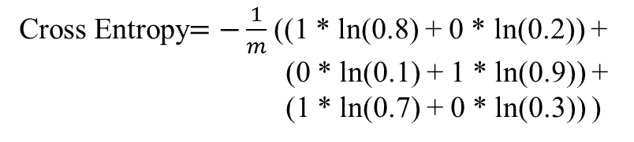
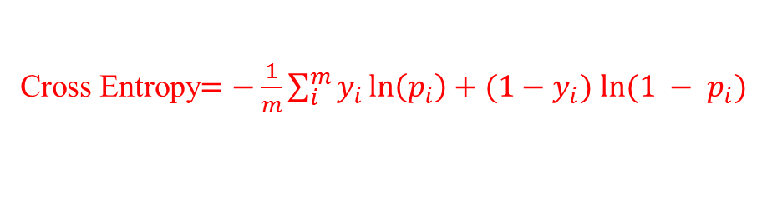
How do we calculate optimal weights and biases?
Our Goal –
Is to formulate a error function and
To optimize (minimize) the error function using Gradient Descent Algorithm
Formulating Cross Entropy Function
Annual Income | Age | Current Balance | Credit Rating | Defaulter
10,000,00 | 26 | 2,000,00 | 450 | 1
12,000,00 | 32 | 7,000,00 | 750 | 0
8,000,00 | 29 | 3,000,00 | 530 | 1
Probability
0.8
0.1
0.7
Cross Entropy$=−\frac{1}{m}\sum_{i}^{m}{y_{i}\ln\left(p_{i}\right)+{(1−y}_{i}) ln⁡(1 − p_{i})}$
Cross Entropy$=−\frac{1}{m}$ ((1 * ln(0.8) + 0 * ln(0.2)) +
(0 * ln(0.1) + 1 * ln(0.9)) +
(1 * ln(0.7) + 0 * ln(0.3)) )
Cross Entropy$=−\frac{1}{3}$ (1 * ln(0.8) + 1 * ln(0.9) + 1 * ln(0.7)) = 0.23

Slide 12
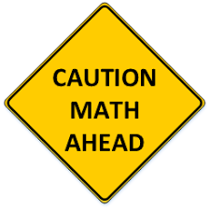

Slide 13
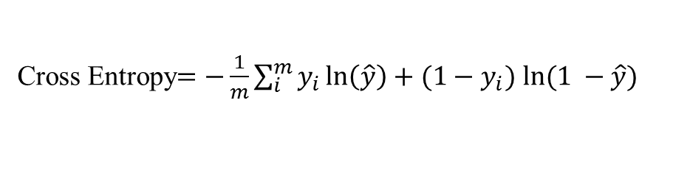
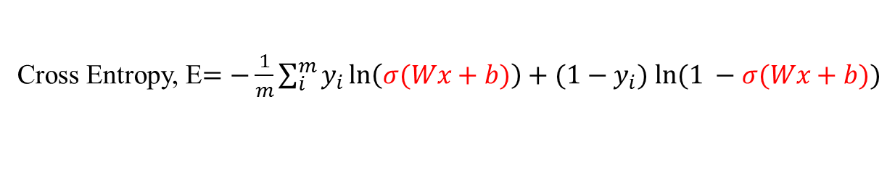
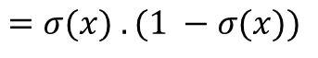
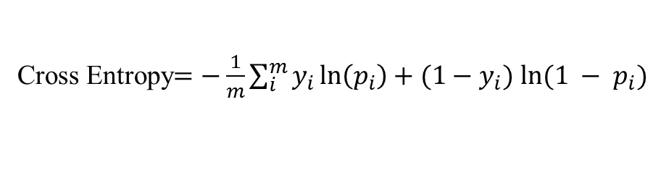
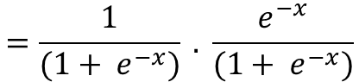
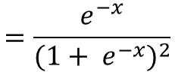
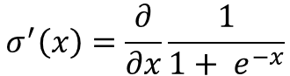
How do we calculate optimal weights and biases?
Our Goal –
Is to formulate a error function and
To optimize (minimize) the error function using Gradient Descent Algorithm
Minimizing Cross Entropy (Error Function)
Cross Entropy$=−\frac{1}{m}\sum_{i}^{m}{y_{i}\ln\left(p_{i}\right)+{(1−y}_{i}) ln⁡(1 − p_{i})}$
Cross Entropy$=−\frac{1}{m}\sum_{i}^{m}{y_{i}\ln\left(\hat{y}\right)+{(1−y}_{i}) ln⁡(1 −\hat{y})}$
Cross Entropy, E$=−\frac{1}{m}\sum_{i}^{m}{y_{i}\ln\left(σ(Wx+b)\right)+{(1−y}_{i}) ln⁡(1 −σ(Wx+b))}$
What is the derivative of sigmoid function?
$$σ^{′}\left(x\right)=\frac{∂}{∂x}\frac{1}{1+ e^{−x}}$$
$$=\frac{e^{−x}}{({1+ e^{−x})}^{2}}$$
$$=\frac{1}{(1+ e^{−x})} . \frac{e^{−x}}{(1+ e^{−x})}$$
$$=σ(x) . (1 −σ(x))$$

Slide 14
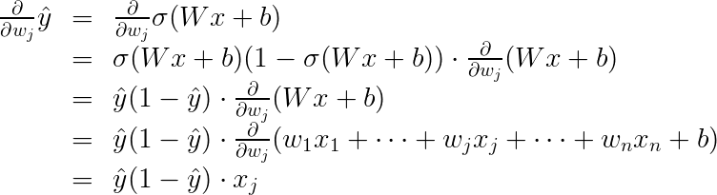

How do we calculate optimal weights and biases?
Our Goal –
Is to formulate a error function and
To optimize (minimize) the error function using Gradient Descent Algorithm
Minimizing Cross Entropy (Error Function)
Cross Entropy$=−\frac{1}{m}\sum_{i}^{m}{y_{i}\ln\left(p_{i}\right)+{(1−y}_{i}) ln⁡(1 − p_{i})}$
Cross Entropy$=−\frac{1}{m}\sum_{i}^{m}{y_{i}\ln\left(\hat{y}\right)+{(1−y}_{i}) ln⁡(1 −\hat{y})}$
Cross Entropy, E$=−\frac{1}{m}\sum_{i}^{m}{y_{i}\ln\left(σ(Wx+b)\right)+{(1−y}_{i}) ln⁡(1 −σ(Wx+b))}$

Slide 15
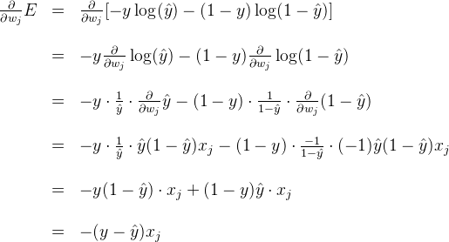
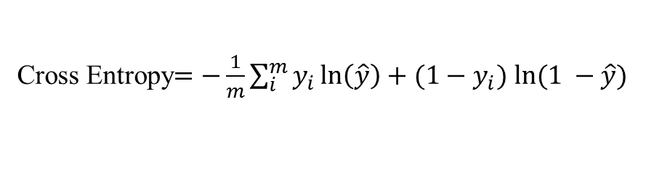

How do we calculate optimal weights and biases?
Our Goal –
Is to formulate a error function and
To optimize (minimize) the error function using Gradient Descent Algorithm
Minimizing Cross Entropy (Error Function)
Cross Entropy$=−\frac{1}{m}\sum_{i}^{m}{y_{i}\ln\left(\hat{y}\right)+{(1−y}_{i}) ln⁡(1 −\hat{y})}$
Cross Entropy, E$=−\frac{1}{m}\sum_{i}^{m}{y_{i}\ln\left(σ(Wx+b)\right)+{(1−y}_{i}) ln⁡(1 −σ(Wx+b))}$

Slide 16
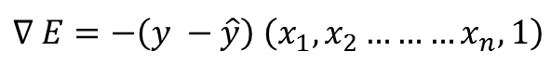
How do we calculate optimal weights and biases?
Our Goal –
Is to formulate a error function and
To optimize (minimize) the error function using Gradient Descent Algorithm
Minimizing Cross Entropy (Error Function)
Cross Entropy$=−\frac{1}{m}\sum_{i}^{m}{y_{i}\ln\left(\hat{y}\right)+{(1−y}_{i}) ln⁡(1 −\hat{y})}$
Cross Entropy, E$=−\frac{1}{m}\sum_{i}^{m}{y_{i}\ln\left(σ(Wx+b)\right)+{(1−y}_{i}) ln⁡(1 −σ(Wx+b))}$
What does this mean?
$$∇ E=−\left(y −\hat{y}\right) \left(x_{1},x_{2}………x_{n}, 1\right)$$
The gradient is the scalar times the coordinates of the point. And the scalar is the difference between the actual label and prediction
Annual Income | Age | Current Balance | Credit Rating | Defaulter
10,000,00 | 26 | 2,000,00 | 450 | 1
12,000,00 | 32 | 7,000,00 | 750 | 0
8,000,00 | 29 | 3,000,00 | 530 | 1
Probability
0.8
0.1
0.7

Slide 17
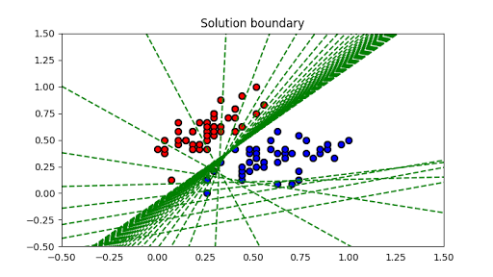
Neural Network Classifier after 50 iterations

Slide 18
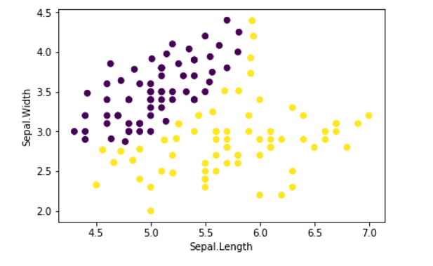
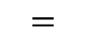
What about Non-Linear Data?
Non-Linear Classification Boundary
Perceptron can only classify linear data. But how can we use Perceptron to classify Non-linear data?
$$=$$
Multi-Layer Perceptron
Perceptron 1
Perceptron 2
Perceptron 3
Multi-Layer Perceptron (MLP) is also known as Neural Network

Slide 19
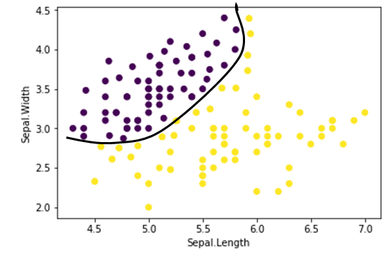
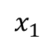
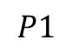
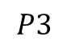
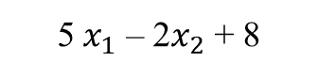
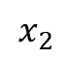
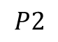
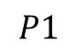
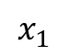
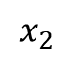
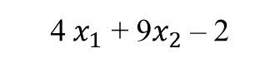
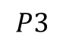
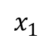
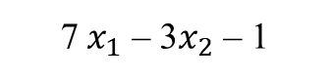
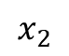
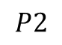
MLP aka Neural Network
5 $x_{1}$ – 2$x_{2}$ + 8
$$x_{1}$$
5
$$P1$$
-2
8
$$x_{2}$$
$$P1$$
7 $x_{1}$ – 3$x_{2}$ – 1
2
$$x_{1}$$
7
4
$$P2$$
-3
-1
$$P2$$
7
$$x_{2}$$
-9
$$P3$$
4 $x_{1}$ + 9$x_{2}$ – 2
$$x_{1}$$
4
$$P3$$
9
-2
$$x_{2}$$

Slide 20
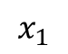










MLP aka Neural Network
$$x_{1}$$
5
-2
8
$$x_{2}$$
5
8
$$P1$$
2
2
$$x_{1}$$
7
$$x_{1}$$
7
4
4
-2
4
-1
7
-3
-1
$$P2$$
7
-9
-9
$$x_{2}$$
-3
output layer
$$x_{2}$$
9
-2
$$P3$$
input layer
hidden layer
$$x_{1}$$
4
9
-2
$$x_{2}$$

Slide 21














Deep Neural Network
5 $x_{1}$ – 2$x_{2}$ + 8
Produces Non-Linear Boundaries
$$x_{1}$$
5
-2
8
$$x_{2}$$
$$P1$$
5
7
- 6
7 $x_{1}$ – 3$x_{2}$ – 1
$$x_{1}$$
7
$$P2$$
2
-1
-9
7
-3
$$x_{2}$$
$$P2$$
3
4
2
4 $x_{1}$ + 9$x_{2}$ – 2
$$x_{1}$$
$$P3$$
4
9
-2
$$x_{2}$$

Slide 22










MLP aka Neural Network
$$x_{1}$$
5
-2
8
$$x_{2}$$
$$P1$$
-2
5
7
- 6
5
8
-2
5
$$x_{1}$$
7
$$P2$$
2
$$x_{1}$$
7
- 6
2
7
-1
7
-2
4
-1
3
7
-3
-9
-9
$$x_{2}$$
$$P2$$
$$x_{2}$$
-3
-3
4
2
output layer
3
input layer
9
-2
2nd hidden layer
-3
4
2
1st hidden layer
$$x_{1}$$
4
$$P3$$
9
-2
$$x_{2}$$

Slide 23



Forward Propagation (Output and Calculation of Error Function)
5
8
5
-2
$$x_{1}$$
7
- 6
2
7
-2
4
-1
3
7
$$\hat{y}$$
-9
$$x_{2}$$
-3
-3
4
2
output layer
input layer
9
-2
2nd hidden layer
1st hidden layer
$$\hat{y}= σ \left(\begin{matrix}2 \\ −9\end{matrix} ∗\left(σ \left(\left[\begin{matrix}5 & 7 & −3 \\ −2 & 3 & 4\end{matrix}\right] ∗ \left(σ \left(\left[\begin{matrix}5 & −2 \\ 7 & −3 \\ 4 & 9\end{matrix}\right] ∗ \left[\begin{matrix}x_{1} \\ x_{2}\end{matrix}\right]+ \left[\begin{matrix}8 \\ −1 \\ −2\end{matrix}\right]\right)\right)+ \left[\begin{matrix}−6 \\ 2\end{matrix}\right]\right)\right)+7\right)$$
1st hidden layer activation
2nd hidden layer activation
output

Slide 24



Back Propagation (Weights and Biases get updated)
5
8
5
-2
$$x_{1}$$
7
- 6
2
7
-2
4
-1
3
7
$$\hat{y}$$
-9
$$x_{2}$$
-3
-3
4
2
output layer
input layer
9
-2
2nd hidden layer
1st hidden layer
$$∇ E=−\left(y −\hat{y}\right) \left(x_{1},x_{2}\right)$$
a function of W (weights) and b (biases)
also a function of W (weights) and b (biases)
$$Wnew=Wold − η ∇ E$$
updated weights for next iteration
$$bnew=b old− η ∇ E$$
updated biases for next iteration

Slide 25






Back Propagation (Weights and Biases get updated)
5
8
5
3
2
-1
-2
Weights and biases gets updated after the first iteration and the process continues… till a minima is achieved. Local minima or global minima?
-1
$$x_{1}$$
7
- 6
2
$$x_{1}$$
4
-2
4
7
9
-2
4
-1
3
7
$$\hat{y}$$
5
-1
3
6
-3
$$\hat{y}$$
-9
3
$$x_{2}$$
-3
-3
4
2
output layer
$$x_{2}$$
-2
2
-1
1
output layer
input layer
9
-2
2nd hidden layer
input layer
-1
1
2nd hidden layer
1st hidden layer
1st hidden layer
initial point
Error Function (function of weights and biases)
after 1st iteration
local minima
global minima

Slide 26
Neural Network using NumPy
Hands-on exercise

Slide 27
Tuning Deep Neural Networks
A neural network may fail because of
Poor network architecture
Noisy data
Large amount of data
Poor initialization of weights and biases
Poor choice of learning rate
Model overfitting
Exploding gradients
Vanishing gradients
And much more…
Neural network models are much more difficult to tune as compared to other machine learning techniques

Slide 28




Tuning Deep Neural Networks
Tuning: Batch Vs Stochastic Gradient Descent
Obs | $$x_{1}$$ | $$x_{2}$$ | y
1
.
100
Obs | $$x_{1}$$ | $$x_{2}$$ | y
1
2
.
.
.
.
100000
Obs | $$x_{1}$$ | $$x_{2}$$ | y
1
.
100
1000 mini-batches of
100 observations each
.
.
.
Obs | $$x_{1}$$ | $$x_{2}$$ | y
1
.
100

Slide 29




Tuning Deep Neural Networks
Tuning: Batch Vs Stochastic Gradient Descent
Obs | $$x_{1}$$ | $$x_{2}$$ | y
1
.
100
Obs | $$x_{1}$$ | $$x_{2}$$ | y
1
.
100
1 complete epoch
.
.
.
.
.
.
Obs | $$x_{1}$$ | $$x_{2}$$ | y
1
.
100

Slide 30
Tuning Deep Neural Networks
Tuning: Learning rate decay
starting point
starting point
optimal point
optimal point
high learning rate
low learning rate

Slide 31



Tuning Deep Neural Networks
Tuning: Early Stopping
Underfitting
Just Right
Overfitting
Its always better to overfit the model, and then try to regularize the model to make it right

Slide 32
Tuning Deep Neural Networks
Tuning: Early Stopping
Underfitting
Just Right
Overfitting
Epoch 1
Training Error: Big
Testing Error: Big
Epoch 20
Training Error: Small
Testing Error: Small
Epoch 100
Training Error: Tiny
Testing Error: Large

Slide 33




Tuning Deep Neural Networks
Tuning: L1 and L2 Regularization
Model 1: $x_{1}+ x_{2}$
Model 1: ${10x}_{1}+ {10x}_{2}$
Which model is better?
both model gives the same boundary line
Prediction for blue point in Model 1: $σ(1+1)=0.88$
Prediction for blue point in Model 1: $σ(10+10)=0.9999999979$
Is super accurate or overfitted?

Slide 34



Tuning Deep Neural Networks
Tuning : L1 and L2 Regularization
Model 1: $x_{1}+ x_{2}$
Model 1: ${10x}_{1}+ {10x}_{2}$
Here our predictions are better
But functions becomes much steeper
So it is difficult to do gradient descent in this case
Derivatives are mostly close to zero at the centre and
Derivatives are very large at both the ends
How to solve this?

Slide 35




Tuning Deep Neural Networks
Tuning : L1 and L2 Regularization
Model 1: $x_{1}+ x_{2}$
Model 1: ${10x}_{1}+ {10x}_{2}$
Penalizing large weights
Cross Entropy$=−\frac{1}{m}\sum_{i}^{m}{y_{i}\ln\left(\hat{y}\right)+{(1−y}_{i})\ln\left(1 −\hat{y}\right)+ λ \left(\left|w_{1}\right|+\left|w_{2}\right|+ …+\left|w_{n}\right|\right)}$
L1 Regularization
Cross Entropy$=−\frac{1}{m}\sum_{i}^{m}{y_{i}\ln\left(\hat{y}\right)+{(1−y}_{i})\ln\left(1 −\hat{y}\right)+ λ \left(w_{1}^{2}+w_{2}^{2}+ …+w_{n}^{2}\right)}$
L2 Regularization

Slide 36






Tuning Deep Neural Networks
Tuning : Dropout
5
8
5
5
8
5
-2
-2
$$x_{1}$$
7
- 6
2
$$x_{1}$$
7
- 6
2
7
7
-2
4
-1
3
7
$$\hat{y}$$
-2
4
-1
3
7
$$\hat{y}$$
-9
-9
$$x_{2}$$
-3
-3
4
2
output layer
$$x_{2}$$
-3
-3
4
2
output layer
input layer
9
-2
2nd hidden layer
input layer
9
-2
2nd hidden layer
1st hidden layer
1st hidden layer
sometimes some nodes get very high weights and it dominates the training process
so we randomly turn off the nodes in each epoch
we pass a dropout parameter during the training process, e.g. probability each node will be dropped = 0.2

Slide 37

Tuning Deep Neural Networks
Tuning : Dropout
dead neuron

Slide 38





Tuning Deep Neural Networks
Tuning : Vanishing Gradient
gradients are almost equal to zero at large
values, so during backpropagation the weights
in large networks don’t get updated and training does not happen properly
$$∇ E=−\left(y −\hat{y}\right) \left(x_{1},x_{2}, …,x_{n}\right)$$
How to solve this problem?
a function of W (weights) and b (biases)
Use better activation functions
also a function of W (weights) and b (biases)
$$∇ E ≈0$$
due to vanishing gradients
$$W=W − η ∇ E$$
weights don’t get updated
$$b=b − η ∇ E$$
biases don’t get updated

Slide 39


Tuning Deep Neural Networks
Tuning : Vanishing Gradient
Tanh Function
ReLU Function
https://dashee87.github.io/data%20science/deep%20learning/visualising-activation-functions-in-neural-networks/

Slide 40
Tuning Deep Neural Networks
Tuning : Random Restart
Starting Point
Starting Point
Local Minima
Global Minima
Global Minima
Random Restarts:
Xavier Initialization
He Initialization
Gaussian Initialization

Slide 41




Tuning Deep Neural Networks
Tuning : Momentum $(β)$
Average of the previous steps
Starting Point
$$β^{3}$$
$$β^{2}$$
$$β$$
1
Local Minima
Global Minima
Momentum helps to reach the global optimum point by pushing out from the local minima points

Slide 42
Tuning Deep Neural Networks
Tuning : Optimizers
SGD (Stochastic Gradient Descent)
Learning rate
Momentum: takes average of previous steps
Nesterov Momentum: slows down the gradient when it is closer to the solution
Adam (Adaptive Moment Estimation)
It uses a complicated exponential learning rate decay by taking both average as well as the variance of the
previous steps
RMSProp (RMS stands for Root Mean Squared Error)
It decreases the learning rate by dividing it by an exponentially decaying average of squared gradients.

Slide 43


Tuning Deep Neural Networks
Tuning : Optimizers

Slide 44
Deep Neural Network using Keras
Hands-on exercise

Slide 45

Convolutional Neural Networks
How computers interpret images?
Grayscale image

Slide 46


Convolutional Neural Networks
How computers interpret images?
Blue channel
Green channel
Red channel
Colour image

Slide 47


Convolutional Neural Networks
How computers interpret images?

Slide 48

Convolutional Neural Networks
Why CNN?
5 pixels
.
.
.
.
.
.
5 pixels
20 nodes
20 nodes
2 nodes
1st hidden layer
2nd hidden layer
output layer
25 nodes
No of Parameters = 25*20 + 20 = 570
No of Parameters = 20*2 + 2 = 42
No of Parameters = 20*20 + 20 = 420
Total number of trainable parameters = 570 + 420 + 42 = 1032 parameters only in 5x5 image with 2 hidden layers

Slide 49
Convolutional Neural Networks
Why CNN?
Large number of trainable parameters in ANN which increases computational complexity
ANN treats all image pixels as independent to each others
ANN does not take into account the spatial relationship between the pixels, so it fails to identify the patterns in the image pixels
Whereas, CNNs use sparsely connected layers which reduces total number of trainable parameters
CNNs accepts matrices as input, so we can explore spatial relationship between the pixels in the image

Slide 50
Convolutional Neural Networks
Why CNN?
1st row
spatial information between
pixels is distorted
4 pixels
2nd row
4 pixels
Output
layer
3rd row
4th row
Fully connected
layer

Slide 51
Convolutional Neural Networks
Why CNN?
1st row
4 pixels
2nd row
4 pixels
Output
layer
Now, every hidden node is connected to a local
region of pixels and can find out the local patterns
in the image
3rd row
Then output layers combines the findings of each
hidden nodes and predicts the final output
4th row

Slide 52
Convolutional Neural Networks
Why CNN?
We can rearrange each of these vectors (input and hidden layers in previous layer) as matrices
4 pixels
Output layer
Convolutional layer
4 pixels
We can add more localized hidden nodes to find more patterns
In the image
Convolutional layer

Slide 53
Convolutional Neural Networks
How Convolutional layers are generated?
We introduce kernels or filters with random weights which convolves over the whole image to create localized
convolutional layer
0
1
1
1
0
0
0
1
-1
-1
4 pixels
-1
1
0
0
1
0
convolution operator
0
1
0
0
filter/kernel
4 pixels

Slide 54

Convolutional Neural Networks
How Convolutional layers are generated?
We introduce kernels or filters with random weights which convolves over the whole image to create localized
convolutional layer
0
1
1
1
started learning
patterns of the
digit 7 (seven)
-1
-1
0
0
1
0
0
0
1
-1
1
0
1
0
0
0
1
0
filter/kernel
1
0
0
0
1
0
0
convolutional layer
input layer
$$ReLU\left(sum \left(\begin{matrix}−1 ∗0 & −1 ∗1 \\ −1 ∗0 & 1 ∗0\end{matrix}\right)\right)=0$$

Slide 55




Convolutional Neural Networks
How Convolutional layers are generated?
$$=$$
filter
input layer

Slide 56

Convolutional Neural Networks
How many filters do we need?
We may like to detect:
Teeth
Tongue
Whiskers
So for every features in the image
we will convolve different filters
with respect to the image to detect
those features. For instance, one
filter for teeth, one for tongue and
another for whiskers and then we
stack up those convolutional layers
as one final layer

Slide 57



Convolutional Neural Networks
How many filters do we need?
input layer
four filters to detect four different
patterns in the image

Slide 58

Convolutional Neural Networks
How many filters do we need?

Slide 59





Convolutional Neural Networks
How many filters do we need?
input layer
filters
convolutional layer

Slide 60



Convolutional Neural Networks
How many filters do we need?
$$\left[CONV LAYER\right]$$
$$\left[CONV LAYER\right]$$
Output
convolutional layer is passed through multiple
other convolutional layers to find out patterns
within the patterns (complex patterns)
convolutional layer

Slide 61
Convolutional Neural Networks
Tuning parameters in CNN
Number of filters
Size of filters
Stride of filters
Padding

Slide 62
Convolutional Neural Networks
Tuning parameters in CNN: Stride and Padding
0
1
1
1
1
0
1
?
1
-1
-1
0
0
0
1
0
1
0
?
-1
1
0
0
1
0
0
?
?
?
filter/kernel
0
1
0
0
0
1
0
0
0
0
1

Slide 63
Convolutional Neural Networks
Tuning parameters in CNN: Stride and Padding
0
1
1
1
1
0
0
1
?
0
1
0
1
-1
-1
0
0
0
1
0
0
1
0
?
1
0
0
-1
1
0
0
1
0
0
0
?
?
?
0
0
0
filter/kernel
0
1
0
0
0
0
1
0
0
0
0
0
1
Padding
0
0
0
0
0
0

Slide 64

Recurrent Neural Networks
Temporal dependencies – it means dependency of input/independent variables over time
Is this dog walking or running?
"He turned out the light and went into Jem's room. He would be there all night, and he would be there when Jem waked up in the morning."
To Kill a Mockingbird, Harper Lee
Who is ‘He’ here?

Slide 65








Recurrent Neural Networks
time step 1
Arko
$$x_{1}$$
5
8
next hidden layer/ output layer
time step 2
is
$$x_{2}$$
1
1
next hidden layer/ output layer
Should they have
Same weights?
time step 3
cool,
$$x_{3}$$
-2
-3
next hidden layer/ output layer
-3
time step 4
be
$$x_{4}$$
0
next hidden layer/ output layer
Should they have
Same weights?
4
time step 5
cool,
$$x_{5}$$
4
next hidden layer/ output layer
2
time step 6
be
$$x_{6}$$
7
next hidden layer/ output layer
Who is ‘him’ here?
-6
time step 7
like
$$x_{7}$$
-1
next hidden layer/ output layer
7
time step 8
him
$$x_{8}$$
9
next hidden layer/ output layer

Slide 66








Recurrent Neural Networks
time step 1
Arko
$$x_{1}$$
5
8
Activation/
Information/
Memory
time step 2
is
$$x_{2}$$
1
1
time step 3
cool,
$$x_{3}$$
-2
-3
-3
time step 4
be
$$x_{4}$$
0
4
time step 5
cool,
$$x_{5}$$
4
2
time step 6
be
$$x_{6}$$
7
4
time step 5
like
$$x_{5}$$
4
2
time step 6
him
$$x_{6}$$
7

